Slide 1
Smart Parking System
Project Purpose: A mobile application that provides drivers with real-time parking availability information in busy areas using IoT sensors and data analytics.
Goal Statement: The goal of this project is to develop a reliable and user-friendly mobile application that integrates IoT sensors and data analytics to deliver real-time parking availability, reducing search times and traffic congestion in high-demand urban areas.

Slide 2
Meet the Team
Owen Edwards
edwardoa@mail.uc.edu
Andrew Pipo
pipoat@mail.uc.edu
937-631-5036
Advisor: Jeremy Hill
hill4jy@ucmail.uc.edu

Slide 3
Project Abstract
This project involves the development of a mobile application that leverages IoT technology and data analytics to provide real-time parking availability in busy urban areas. The system utilizes IoT sensors to monitor parking spots and collects real-time data, which is processed and analyzed to deliver accurate parking information to drivers. The mobile application offers an intuitive interface, enabling users to locate available parking spaces quickly and efficiently. By integrating mobile application development, IoT infrastructure, and advanced data analytics, this solution aims to improve parking management and reduce congestion in densely populated areas.

Slide 4
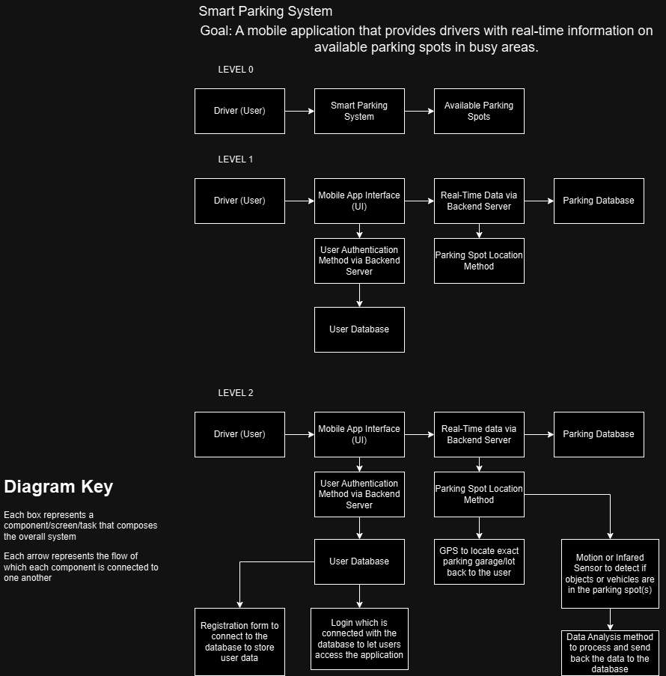
User Stories and Design Diagrams
User Stories
As a driver in a busy area, I want to view available parking spots in real time so that I can find parking quickly and avoid wasting time searching.
As a commuter, I want to reserve a parking spot in advance so that I can ensure I have a place to park when I arrive at my destination.
As a city planner, I want to analyze parking availability data so that I can optimize parking infrastructure and reduce congestion in busy areas.
As a parking facility manager, I want to track the occupancy rate of parking spots so that I can manage space more efficiently and maximize revenue.
Design Diagrams

Slide 5
Major Project Constraints
The Smart Parking System project faces several constraints that shape the design and potential solutions. Economically, the project operates under a limited budget, relying on freeware and open-source tools. This restricts access to premium software or advanced hardware like high-precision sensors, which could improve the system's accuracy. However, the solution has the potential to contribute to economic development by reducing the time and cost associated with finding parking in busy areas, potentially benefiting local businesses.
Ethical, legal, and security concerns also impact the project. Privacy issues arise from collecting real-time parking data and tracking user locations, requiring strict compliance with data protection laws like GDPR. The system must ensure fairness and avoid creating inequities among different socioeconomic groups. Additionally, strong security measures, such as encryption and secure authentication, are essential to prevent data breaches or unauthorized access. Environmentally, the system aims to reduce vehicle emissions by helping drivers find parking faster, although the deployment of IoT sensors carries a small environmental footprint. Addressing these constraints will help ensure the project is both practical and socially responsible.

Slide 6
Review of Project Progress
All Deliverables have been completed and reviewed by our Advisor, Jeremy Hill, by the respective deadlines
Deliverables completed thus far:
Project proposal
Team formation
Project description
Team contract
Design diagrams
Task lists
Milestones
Timeline
Effort matrix
Project constraints

Slide 7
Expected Accomplishments (for Fall 2024)
Milestone 1: UI/UX and Basic User Authentication
Complete the design and development of a user-friendly interface, including a seamless user authentication system for secure login and access to parking data.
Milestone 2: Backend Server Architecture and Real-Time Communication
Implement the backend architecture, ensuring efficient handling of data from IoT sensors, and establish real-time communication between the app and server for instant parking updates.
Milestone 3: Sensor and Parking Spot Detection System
Integrate IoT sensors for parking spot detection, linking them to the app for accurate, real-time information on available parking spaces.

Slide 8
Division of Work
Andrew Pipo
Develop the backend server architecture
Specify the parking spot location method
Develop the user database structure
Test the parking spot detection system
Refine the real-time data fetching process
Research and specify data analysis methods
Document the backend server setup and communication protocols
Design the system for processing and updating parking spot data
Investigate sensor technologies
Develop methods for linking parking spot data to GPS
Test the data analysis system
Validate the parking location method
Assess database scalability
Develop feedback loops
Owen Edwards
Design the mobile app interface (UI)
Research and integrate user authentication methods
Design a registration form interface
Implement and test login functionality
Test the GPS system integration
Test the entire mobile app UI
Specify security measures
Test the real-time server communication
Validate the user experience
Develop user guides and tutorials
Document the user authentication and database interaction process

Slide 9
Expected Demo at Expo
Operational/Working Mobile Application for Users
Present a walk-through of the application and what users will expect and see
This will include both the frontend of the user interface in addition to the functional backend and database
Small-Scale Implementation of Sensor/GPS to connect with Application
Using Arduino to represent the hardware implementation
User Interaction and Feedback Simulation
Simulate user feedback within the app and how the app will adjust based on user input, demonstrating usability and scalability

